Slide 1
Physical OSI Layer
Group-2

Slide 3
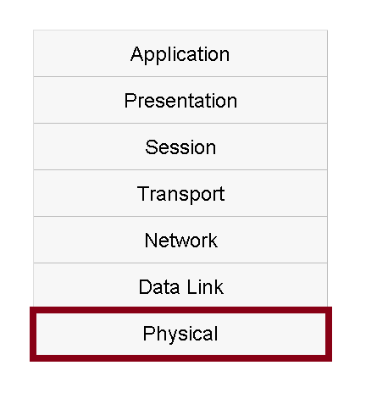
Physical Layer
The Physical Layer is the lowest layer (Layer 1) in the OSI Model.
Fundamental layer underlying any network.
Primarily consists of hardware.
Provides the basic communication channel that two network devices use to send and receive messages.
Provides transmission and reception hardware.

Slide 4
Functions of the Physical Layer
Transmits bits over a physical link between devices.
Encodes bits into a physical signal.
Decodes bits from a physical signal.
Isolates electrical or optical circuits from one another.

Slide 5
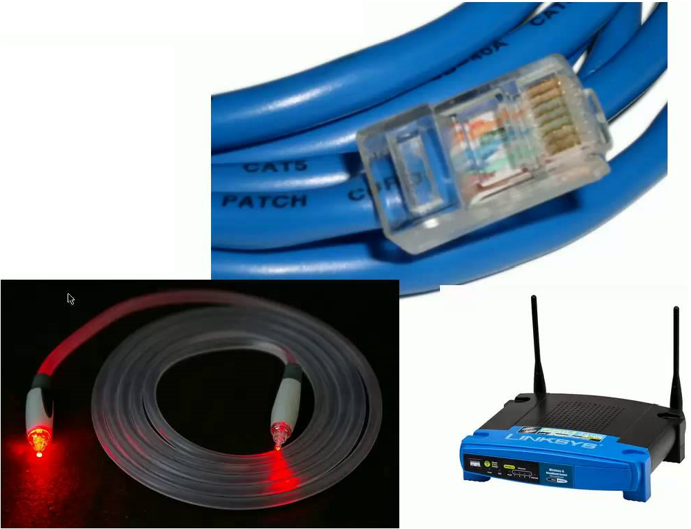
Types of Physical Links
Cabled (wired or fiber optic)
Wireless

Slide 6
Physical Link Properties
Bits (digital signals) are encoded into an analog signal for transmission, decoded at reception.
Most common type of analog signal is an electromagnetic wave
Electrical pulses over wire
Radio Signals through the air
Pulses of light through fiber optics cable

Slide 7

Other Analog Signals are Possible
Sound
Vibration
Pneumatics

Slide 8
Physical Layer Specifications
Hardware specifications are part of the physical layer.
Type of connection.
Electrical, optical, radio, etc.
Specifications for cable or radios.
Physical requirements for connectors, antennas, and other attachments.

Slide 9
Importance of the Physical Layer
Defines the communications hardware used to implement the network.
The remaining OSI Model layers can be implemented entirely in software.
Without the physical layer, the network cannot function.

Slide 10
Wired Examples
Ethernet physical layer
USB physical layer
DSL physical layer
DOCSIS (cable modem) physical layer
Dail-up telephone modem (V.92 standard)

Slide 11
Wireless Radio Examples
IEEE 802.11 (Wi-Fi) physical layers
Bluetooth physical layer
GSM Um interface
LTE physical layer

Slide 12
Optical Examples
Fiber optic (SONET) physical layer.
IRDA (wireless infrared) physical layer.

